Slide 1
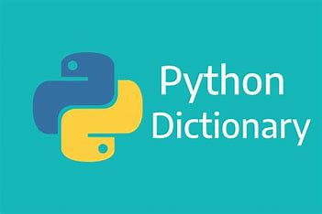
Python Presentation: Dictionaries
Clay Jackson
CS-150-01

Slide 2
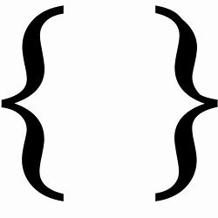
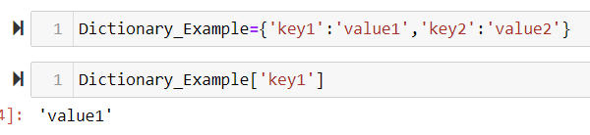
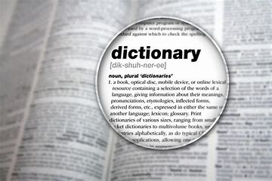
Definition
A dictionary in Python is a collection of key-value pairs.
Each key is connected to a value, and you can use a key to access the value associated with that key.
A key’s value can be a number, a string, a list, or even another dictionary.
Key is the unique identifier to find data and the value is the data
Key is immutable, values are mutable
A dictionary is a collection which is ordered*, changeable and does not allow duplicates.
dictionaries are NOT sequences - the data are NOT stored in order.
Dictionary can be represented by { }

Slide 3
Functions/Methods
.get() – Does NOT generate error
.update() – Only way to update a key
.keys(), values(), items() – choose between extracting keys, values, or pairs in a dictionary
.zip() – Can make two lists into a dictionary

Slide 4
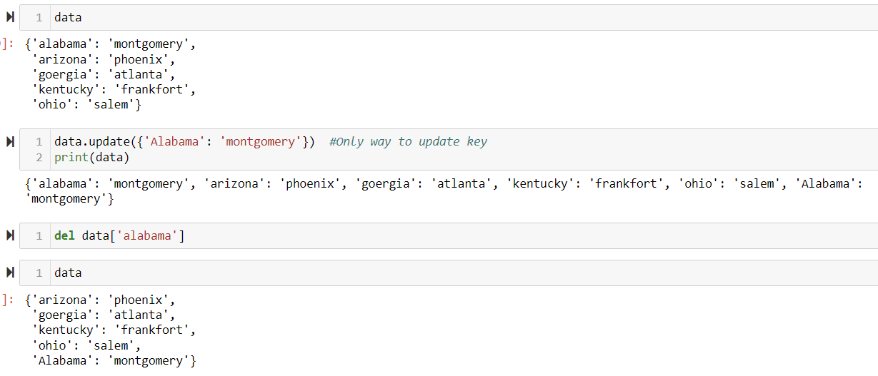
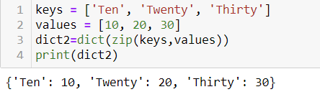
.update() .zip()

Slide 5
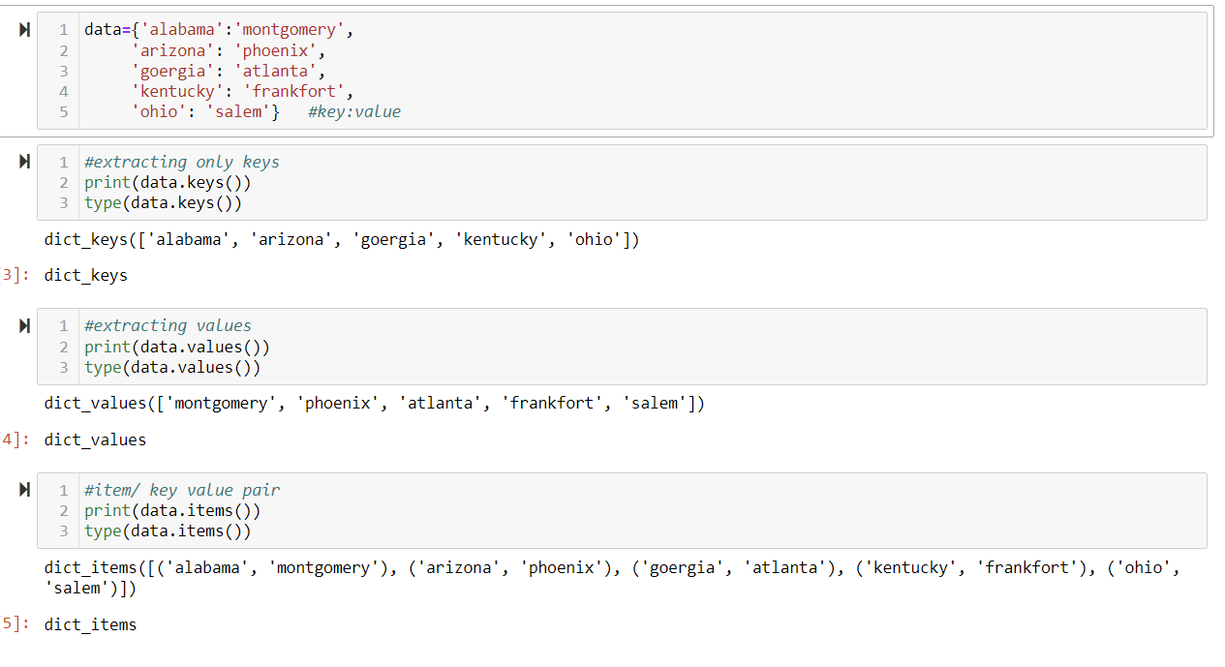
.keys() .values() .items()

Slide 6

Application: Why Use Dictionaries?
Dictionaries allow you to connect pieces of related information.
Allows you to model a variety of real-world objects more accurately.
Think of how many things you look up by one name (key) to find further information (values)
Ex. Translate, Glossary, Encyclopedias

Slide 7
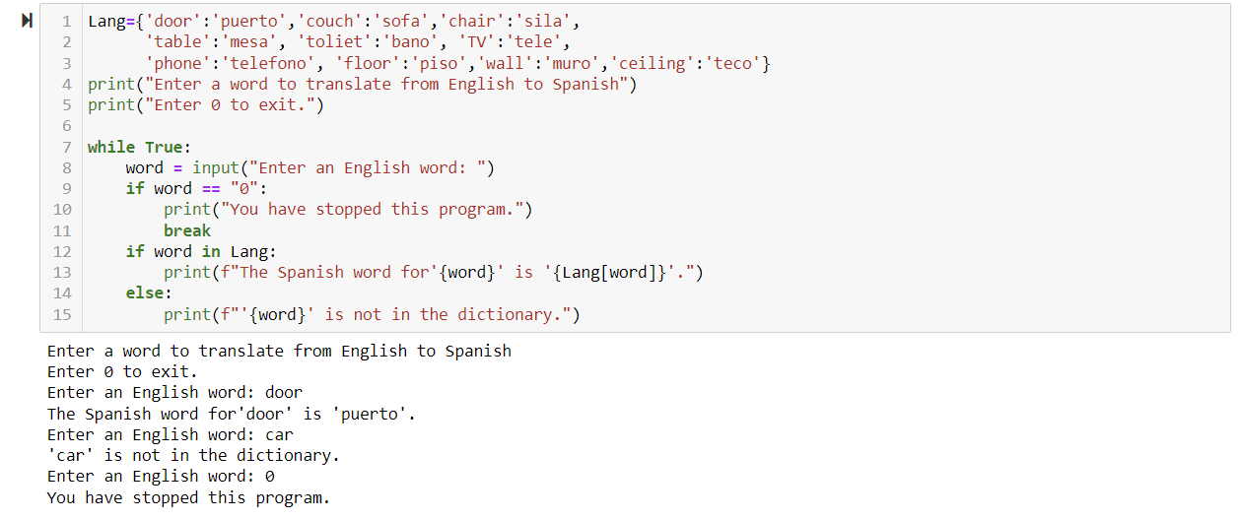
Example: Language Dictionary

Slide 8

Thank You

